Slide 1

Hashing
Generalizing DataIndexedEnglishWordSet: handling collisions, improving performance, and defining hash functions.
Kevin Lin, with thanks to many others.
Notes:
Ask questions anonymously on Piazza. Look for the pinned Lecture Questions thread.
Unlike the theme of previous lectures where we questioned existing invariants and assumptions, this lecture will start off more on-rails to develop a new approach to implementing the Set and Map ADTs.

Slide 2
Feedback from the Reading Quiz
boolean contains(int x) {
return present[x];
}
Runtime analysis of DataIndexedIntegerSet.
N = size of set (very large). contains(732838)
Cost model? Number of array access.
Walkthrough for computing the index for “cat”. How about “at” first?
a = 1 b = 2 c = 3 … x = 24 y = 25 z = 26.
aa = 26 + 1 ab = 26 + 2 ac = 26 + 3 … at = 26 + 20 = 46.
ba = 2*26 + 1 bb = 2*26 + 2 bc = 2*26 + 3 … zz = 26 * 26 + 26.
aaa = 26² + 1*26 + 1 … cat = 3*26² + 1*26 + 20.
Notes:
The reading introduced us to a data organization strategy based on constant-time array indexing. This idea led to two classes: DataIndexedIntegerSet and DataIndexedEnglishWordSet.

Slide 3
DataIndexedStringSet
Notes:
Using only lowercase English words is too restrictive. We’d like a more general solution that can store strings with punctuation and numbers at least.

Slide 4
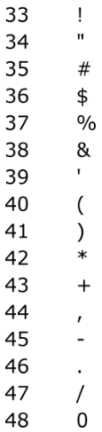
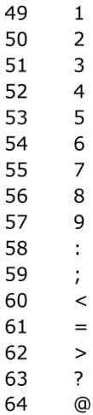
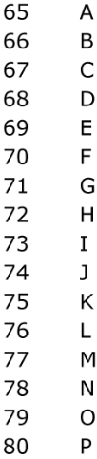
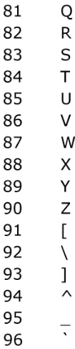
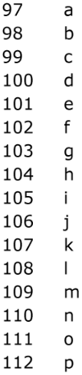
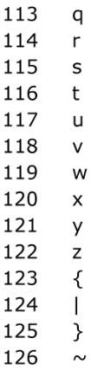
char Representation
The most basic character set used by most computers is called ASCII.
Each possible character is assigned a value between 0 and 127. “Printable” characters are between 33 and 126.
char c = 'D' is like char c = 68

Slide 5
DataIndexedStringSet
Since the maximum value for printable ASCII characters is 126, set the base to 126.
Let’s try to represent the ASCII strings “bee”, “2pac”, and “eGg!”.
bee₁₂₆ = (98 * 126²) + (101 * 126¹) + (101 * 126⁰) = 1,568,675
2pac₁₂₆ = (50 * 126³) + (112 * 126²) + (97 * 126¹) + (99 * 126⁰) = 101,809,233
eGg!₁₂₆ = (101 * 126³) + (71 * 126²) + (103 * 126¹) + (33 * 126⁰) = 203,178,213
Hash Function
Hash Code
Notes:
?: What’s problematic about this approach?

Slide 6
Beyond ASCII
Java chars support other languages and symbols, such as Chinese.
There are 40,959 Chinese characters.
守门员₄₀₉₅₉ = (23432 * 40959²) + (38376 * 40959¹) + (21592 * 40959⁰) = 39,312,024,869,368
...
39,312,024,869,367
39,312,024,869,368
39,312,024,869,369
F
守门呗
守门员
守门呙
T
F
...
Notes:
?: What’s a potential problem with this hash function?

Slide 7
Integer Overflow Collisions
int x = 2147483647;
System.out.println(x);
// 2147483647
System.out.println(x + 1);
// -2147483648
In Java, the largest int is 2,147,483,647.
Going over this limit results in overflow, starting back over at the smallest int.
If there are more unique mappings than unique ints, then collisions will still occur!
DataIndexedStringSet disi;
disi.add("melt banana");
disi.contains("subterrestrial anticosmetic");
// true: both strings hash to 839099497

Slide 8
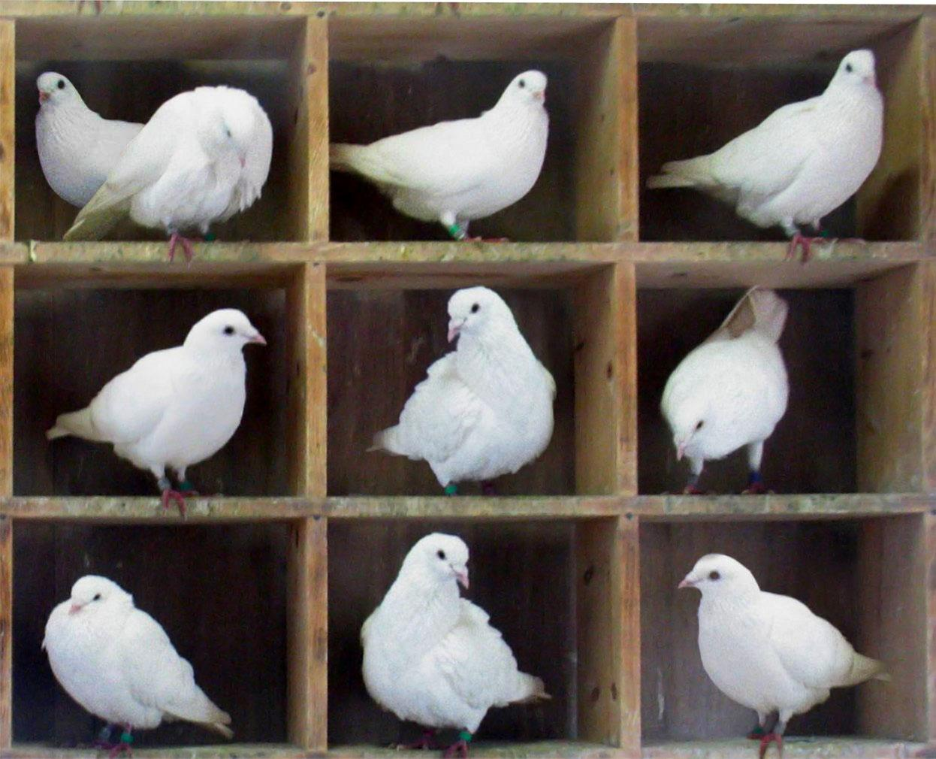
Collisions are Inevitable
There are 4,294,967,296 unique Java ints.
Pigeonhole principle says that if there are more than 4,294,967,296 items, multiple items must share the same hash code.
Too Many Pigeons (BenFrantzDale/Wikimedia)
Notes:
We can’t give each of the 10 pigeons a unique pigeonhole!

Slide 9
Separate Chaining
add("a")
add("a")
add("abomamora")
add("a")
add("abomamora")
add("adevilish")
add("a")
add("abomamora")
add("adevilish")
add("abomamora")
add("a")
add("abomamora")
add("adevilish")
add("abomamora")
contains("adevilish")
Instead of storing a boolean, store a bucket of items at the given index.
Each bucket in our array is initially empty. When an item x gets added at index h…
If bucket h is empty, create a new list containing x and store it at index h.
If bucket h is already a list, add x to this list if it is not already present.
0
1
0
1
0
1
0
1
a
a
a
...
...
...
...
111239443
111239444
111239445
111239443
111239444
111239445
111239443
111239444
111239445
111239443
111239444
111239445
abomamora
adevilish
abomamora
...
...
...
...
Notes:
?: Why is it necessary to check if x is not already present in the bucket before adding x?
?: When would it not be necessary to check if x is already present in the bucket?

Slide 10
Separate Chaining Runtime
Worst case runtime will be proportional to length of longest list, Q.
0
1487
2074
3097
111239443
111239442
...
Worst case time | contains(x) | add(x)
Bushy BSTs | Θ(log N) | Θ(log N)
DataIndexedSet | Θ(1) | Θ(1)
Separate Chaining DataIndexedSet | Θ(Q) | Θ(Q)
bee
...
cat
...
doc
...
abomamora
adevilish
Notes:
?: Why is the runtime for separate chaining in terms of Q, the length of the longest list?

Slide 11
Saving memory with Separate Chaining and modulus
Instead of using the raw hash code, take the modulus of the hash code to compute index.
0
1487
2074
3097
111239443
111239442
0
1
2
3
4
5
6
7
8
9
...
bee
...
abomamora
adevilish
mod 10
cat
cat
...
bee
doc
doc
...
abomamora
adevilish
Notes:
?: Do items with the same hash code (collision) still collide after applying mod 10? What about items with different hash codes?
?: How does this change affect runtime? The length of the longest list, Q?

Slide 12
Hash Table

Slide 13
Hash Table
Data is converted by a hash function into an integer representation called a hash code.
The hash code is reduced to a bucket index with the modulo operator.
Object
抱抱
0
1
2
3
4
5
6
7
8
9
抱抱
포옹
Hash function
الطبيعة
Hash table
Hash code
1034854400
Modulo length
bee
doc
Index
0
están
शानदार

Slide 14
Hash Table Runtime
Good news. We use way less memory and support any String.
Bad news. Worst case runtime is now Θ(Q), where Q is the length of the longest list.
Worst case time | contains(x) | add(x)
Bushy BSTs | Θ(log N) | Θ(log N)
DataIndexedSet | Θ(1) | Θ(1)
Separate Chaining Hash Table | Θ(Q) | Θ(Q)
0
1
2
3
4
Notes:
?: What’s a potential problem with saving memory by using the modulus idea?

Slide 15
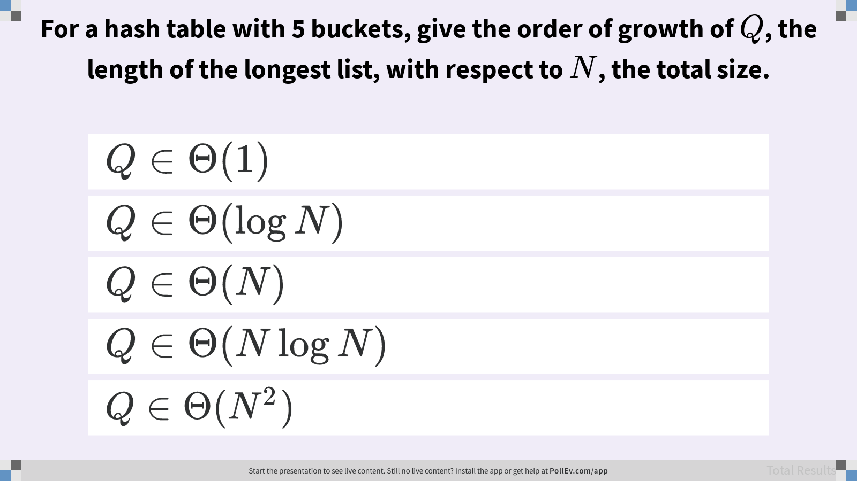
For a hash table with 5 buckets, give the order of growth of Q, the length of the longest list, with respect to N, the total size.

Slide 16
Hash Table Runtime
A
Best case. All items are distributed evenly across 5 buckets, so Q ~ N / 5.
Worst case. All items collide in a single bucket, so Q = N.
Overall. Q ∈ Θ(N)
Worst case time | contains(x) | add(x)
Bushy BSTs | Θ(log N) | Θ(log N)
DataIndexedSet | Θ(1) | Θ(1)
Separate Chaining Hash Table | Θ(Q) | Θ(Q)
0
1
2
3
4
Notes:
?: How can we improve hash table runtime?

Slide 17
Improving Hash Table Runtime
Q
Even if items are distributed evenly, lists are of length Q = N / M. For M = 5, Q ∈ Θ(N).
How can we improve our design to guarantee that Q ∈ Θ(1)?
Worst case time | contains(x) | add(x)
Bushy BSTs | Θ(log N) | Θ(log N)
DataIndexedSet | Θ(1) | Θ(1)
Separate Chaining Hash Table | Θ(Q) | Θ(Q)
0
1
2
3
4
Notes:
Q1: How can we improve our design to guarantee that Q ∈ Θ(1)?

Slide 18
Hash Table Resizing
A
Borrow an idea from ArrayList: resize the number of buckets, M, at the same rate as N.
For example, when N / M ≥ 1.5, double the number of buckets, M.
N / M is the load factor, ensuring the average list length is never more than 1.5 items long.
Worst case time | contains(x) | add(x)
Bushy BSTs | Θ(log N) | Θ(log N)
DataIndexedSet | Θ(1) | Θ(1)
Separate Chaining Hash Table | Θ(Q) | Θ(Q)
0
1
2
3
4
Notes:
?: How can we improve hash table runtime?

Slide 19




Hash Table Resizing
0
1
2
3
4
5
6
7
When N / M ≥ 1.5, double the number of buckets, M.
N = 0 M = 4 N / M = 0
N = 1 M = 4 N / M = 0.25
N = 2 M = 4 N / M = 0.5
N = 3 M = 4 N / M = 0.75
N = 4 M = 4 N / M = 1
N = 5 M = 4 N / M = 1.25
N = 6 M = 4 N / M = 1.5
16
20
0
1
2
3
13
resize M=8
7
3
11
Bucket
Notes:
?: After resizing, where will the bucket go?
?: Fill in the resulting hash table after resizing.

Slide 20
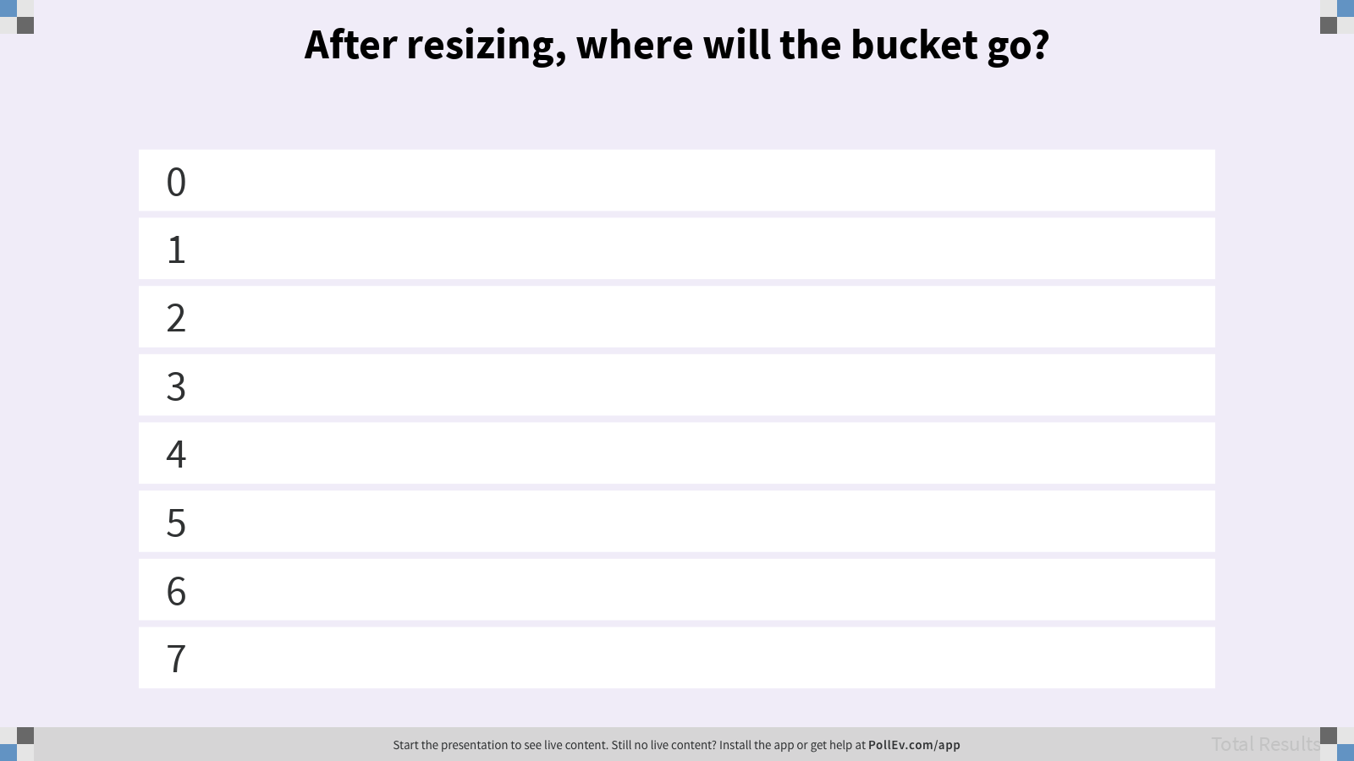
After resizing, where will the bucket go?

Slide 21
Hash Table Resizing
N = 6 M = 8 N / M = 0.75
A
16
0
1
2
3
4
5
6
7
When N / M ≥ 1.5, double the number of buckets, M.
N = 6 M = 4 N / M = 1.5
16
20
3
11
0
1
2
3
13
resize M=8
20
Bucket
13
7
3
11
7
Notes:
?: What is the best case order of growth of Q with respect to N?
?: What is the worst case order of growth of Q with respect to N?

Slide 22
Resizing Hash Table Runtime
Best case. All items are distributed evenly across M ~ N buckets, so Q ∈ Θ(1).
Worst case. All items collide in a single bucket, so Q ∈ Θ(N).
contains(x): Compute hash code of x, take modulus, search the list of items.
add(x): Resize if N / M exceeds the load factor. Add x if the table does not contains(x).
Most add operations will be Θ(Q), but some will be Θ(N).
If we choose to resize by doubling, tripling, etc. the runtime “on average” will be Θ(Q).
Notes:
More detail on resizing in the future.
?: As the hash table designer, what can we do to avoid the worst case scenario? What can we do as a hash table user?

Slide 23
Regarding Even Distribution
Even distribution of item is critical for good hash table performance.
Both tables have load factor of N/M = 1, but the left table is much worse!
x
x
Notes:
?: What’s the order of growth of Q with respect to N for each table?

Slide 24
Is this a valid hash function?
Q
public int hashCode() {
return 17;
}
Algorithms (Sedgewick, Wayne/Pearson)
Notes:
Q1: Is this a valid hash function?

Slide 25
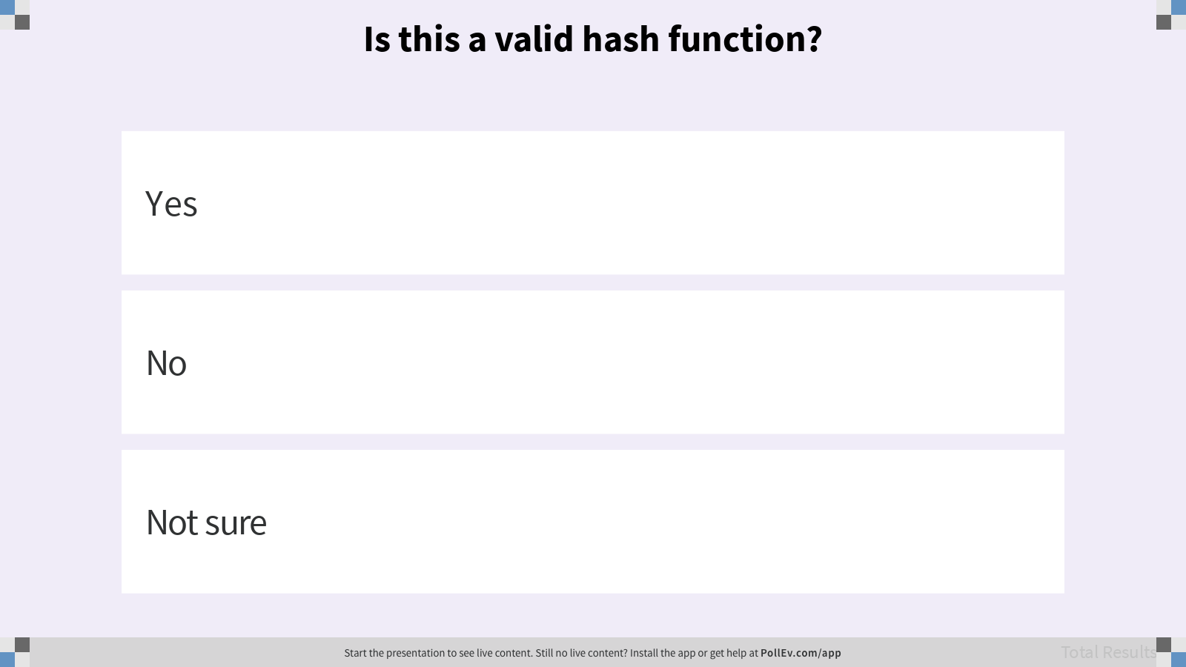
Is this a valid hash function?

Slide 26
Defining Hash Functions
Notes:
IntelliJ code generation demonstration.
?: IntelliJ generate code feature defines equals() and hashCode() methods together. Why?

Slide 27
hashCode Contract
16
20
0
1
2
3
1
Hash function
11
13
7
3
11
2
Modulo length
3
3
Search list
equals
equals
equals
Notes:
We know that unequal items can return the same hash code.
?: Do equal items need to return the same hash code?

